Slide 1


SMART INVENTORY
FOR VIDEO GAMES
System Architecture & Technical Overview

Slide 2
SYSTEM OVERVIEW
CORE TECHNOLOGIES
Backend: FastAPI (Python) with asynchronous endpoints.
Frontend: React.js (Vite) with CSS modules.
Database: MongoDB with GridFS for image storage.
AI Integration: Random Forest & Custom Image Classifiers.

Slide 3
BACKEND ARCHITECTURE
FASTAPI IMPLEMENTATION
The backend is built for speed and scalability using Python's FastAPI framework.
Async Architecture: Non-blocking API endpoints for high performance.
Custom DB Layer: Direct integration with MongoDB via a dedicated service layer.
GridFS: specialized handling for large game cover files.
ML Pipeline: Prediction models are embedded directly into backend services.

Slide 4
API SPECIFICATION
Category | Method | Endpoint | Description
Images | POST | /upload-image | Upload game cover to GridFS
Inventory | POST | /inventory/add | Add new product to collection
Inventory | GET | /inventory/list | Retrieve all products
Prediction | POST | /predict-price | AI price regression model

Slide 5
API SPECIFICATION
Category | Method | Endpoint | Description
Inventory | POST | /inventory/find | Check if a product already exists
Inventory | POST | /inventory/update-quantity | Update quantity of product
Inventory | POST | /inventory//inventory/delete/{product_id} | Delete a product

Slide 6

ARTIFICIAL INTELLIGENCE INTEGRATION
1. IMAGE CLASSIFICATION
Model: game_classifier.pth
Analyzes uploaded cover art.
Predicts Game Title and Genre tags.
2. PRICE PREDICTION
Model: random_forest_price_predictor.joblib
Inputs: Title, Genre, DLC status, F2P, GamePass.
Logic: Maps base prices and applies genre-based one-hot encoding.
Output: Suggested market price (Float).

Slide 7
FRONTEND EXPERIENCE
INTERACTIVE DASHBOARD
Built with React.js and Vite, the UI focuses on efficiency and real-time feedback.
Drag-and-Drop: Seamless cover upload with auto-detection.
Real-time AI: Instant price predictions as data is entered.
Live Inventory: Dynamic table displaying Quantity, Price, and Type.
Direct Actions: Modify stock or prices directly from the card view.

Slide 8
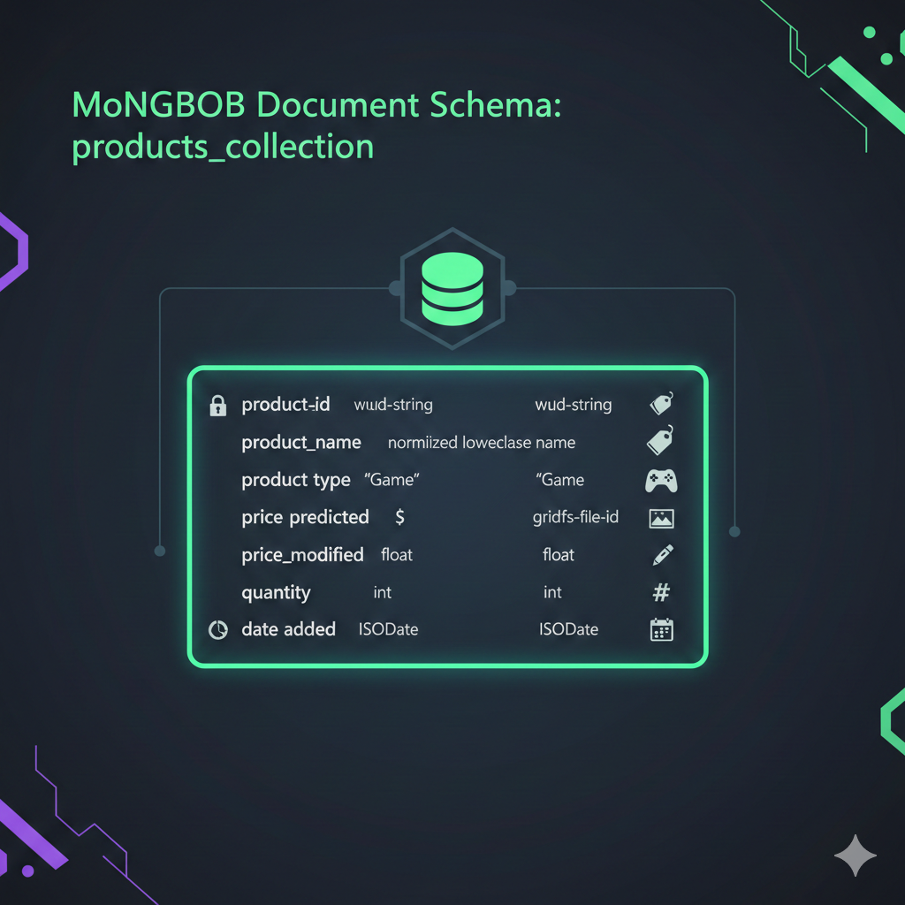

DATABASE
ARCHITECTURE
MongoDB & GridFS Implementation

Slide 9







SCHEMA: PRODUCTS COLLECTION
IDENTITY
PRICING & STOCK
ASSETS
product_id: UUID String
product_name: Normalized
price_predicted: Float
price_modified: Float
quantity: Integer
image_id: GridFS Object ID
product_type: "Game"
date_added: ISODate

Slide 10
IMAGE STORAGE DATA FLOW
1. UPLOAD
2. PROCESS
3. STORE
4. RETRIEVE
Image sent via POST to backend endpoint.
Backend validates and passes file to GridFS.
GridFS saves chunks and returns unique ObjectId.
Frontend fetches via /image/.

Slide 11
Classification Model
Choice of the classification model:
EfficientNet-B0
Since the Dataset is poor :Transfer Learning uses weights pre-trained on the massive ImageNet dataset
EfficientNet is a modern architecture known for being state-of-the-art in both accuracy and efficiency.

Slide 12
dataAugmentation
Since our Dataset is small basic augmentation to change images and have different images is needed we used:
Random Horizontal Flip
Random Rotation
Color Jitter
Random Erasing

Slide 13
Regression Model
Choice was the Random forest regressor
Non Linear (Price prediction doesn’t work with linear regression)
Low Risk of Overfitting: Although individual decision trees are prone to overfitting, the Random Forest aggregates many trees, each trained on a random subset of data and features. This process of bagging (Bootstrap Aggregating) significantly reduces variance and prevents the model from memorizing the noise in your training data.
Random Forest Regressor provides an ideal balance of predictive power, robustness against overfitting, and ease of implementation and interpretation

Slide 14
Dataset used
Major Columns were the title column which means (The Game Name) and the Genres column which means (The Game Type) and these were the output of the classification model
As for helping values we added:
HasDLC (To check if it comes with the DLC or it is only base game)
IsF2p ( Means if it comes with a franchise/pack eg: Resident Evil Pack Contains Resident Evil 1, 2,3,4 …)
IsOnGamePass ( Maybe the game is offered on game pass for free so the price will be that of the gamepass)
IsonDiscount (When there are any promos or offers so the price drops)

Slide 15
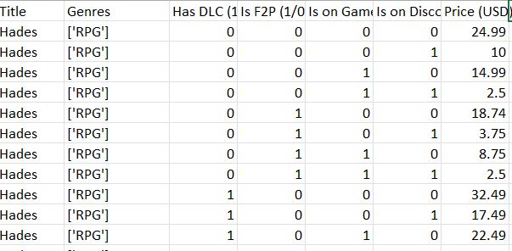
Dataset Sample

Slide 16
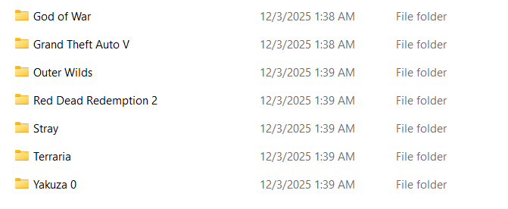
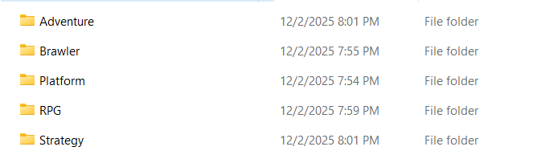
Classification Dataset sample
Example of the folders found in the Adventure folder
Genres Folders

Slide 17
QUESTIONS?
Thank you

